Slide 1
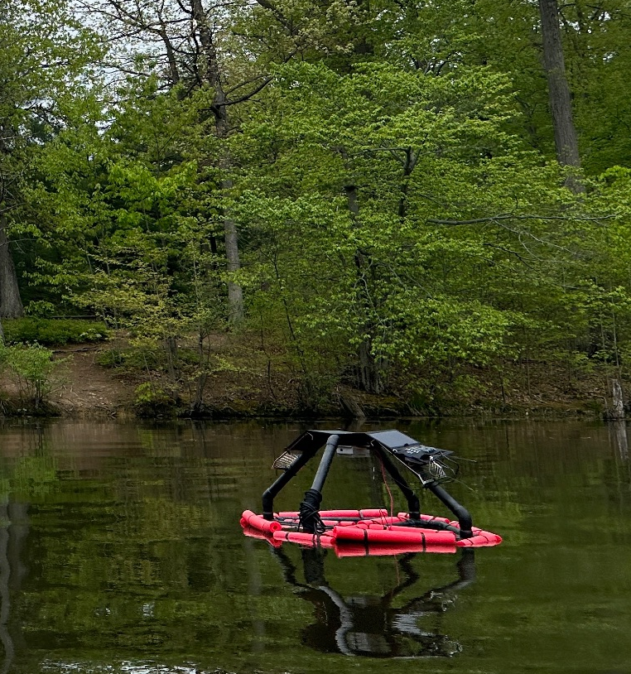
Strnad Presentation
Lake Kilroy Water Quality
By: Vir Patel

Slide 2

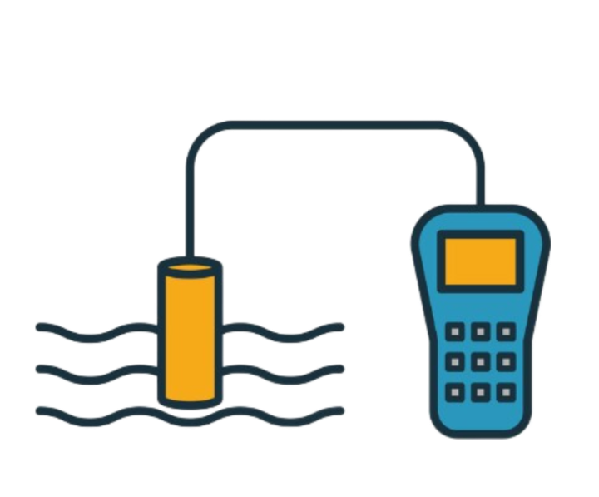
Goals
Buoy
Cloud Water Collection
Create a Buoy with two levels of water quality probes
Create one stop place where anybody can access the data
Stationary Device
Documentation
Create a Stationary water Quality Device
Create an Engineering Journal and a comprehensive manual so anybody can use the devices

Slide 3
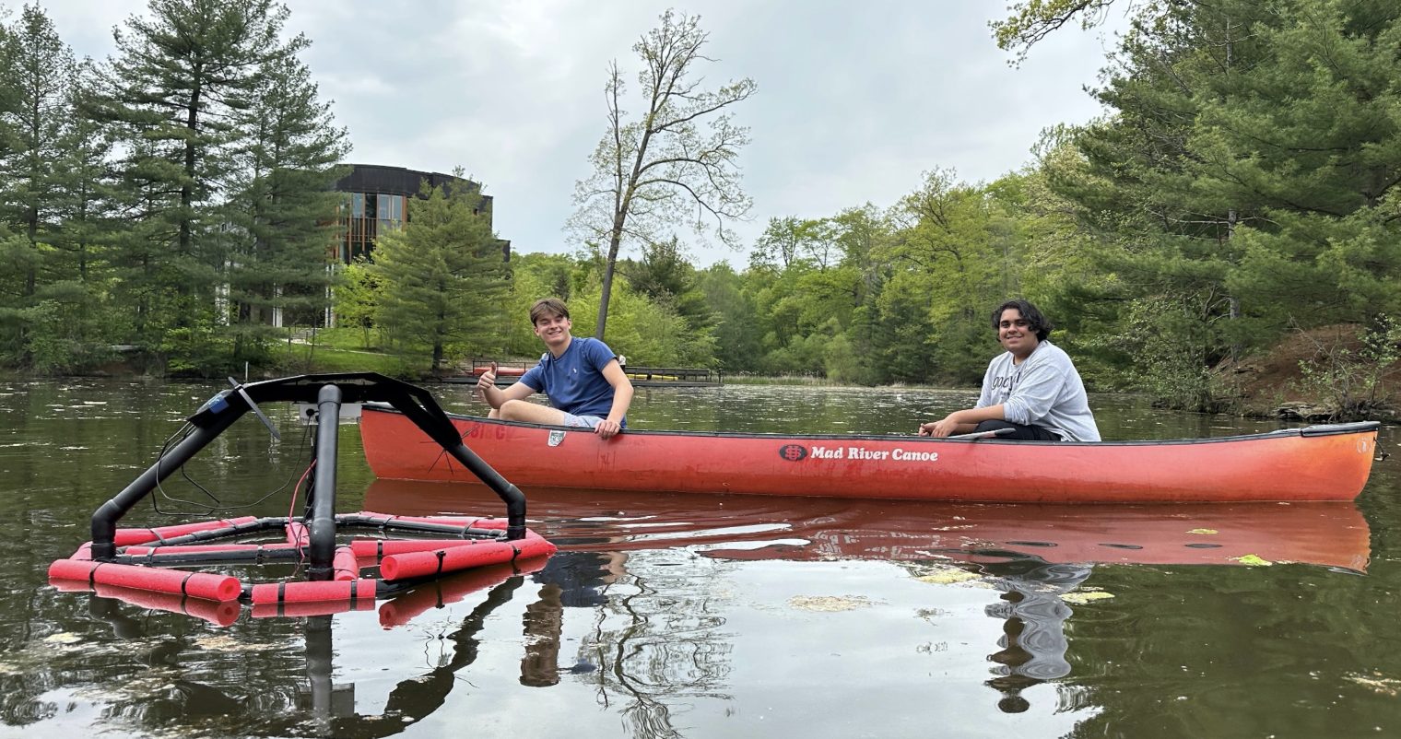
Recap of year one
Created a PVC Buoy that is waterproof
One level of sensors
Wifi extender
System created to upload data to a cloud server

Slide 4

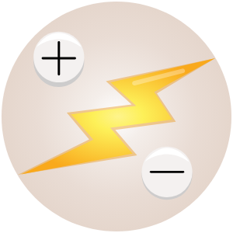

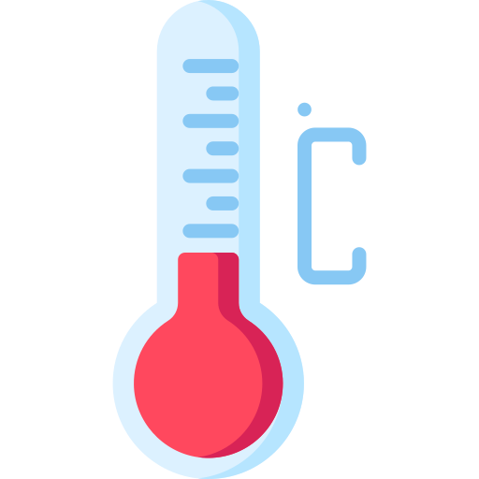
What were we Measuring and Why?
Conductivity
pH
Measure Acidity of water
Extreme pH levels are very harmful
Chemical processes and nutrient availability
Influenced by dissolved ions like salts and minerals
Insights into salinity, nutrient levels, and pollution
Helps detect contamination and assess water quality
Dissolved Oxygen
Temp
High Fluctuations can harm organisms
Impacts Oxygen Levels
Crucial for aquatic life.
Low levels leads to hypoxia
Assesses water quality and ecosystem health.

Slide 5
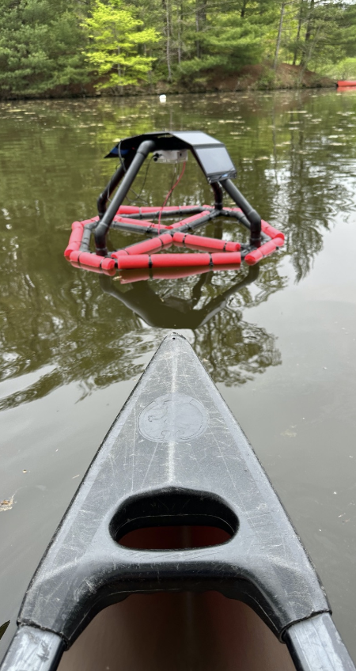
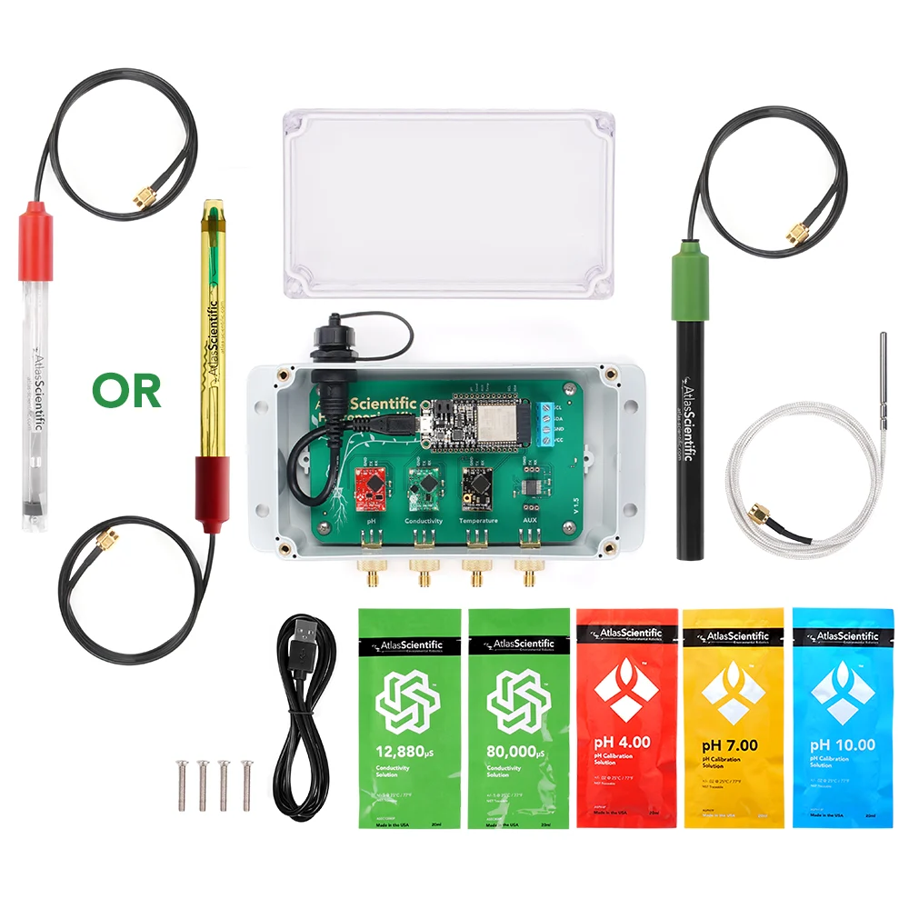
How does each Device work?
The contains two sets of data collector with probes for pH, Dissolved Oxygen, Temperature, and conductivity
The stationary device has a data collector on a garden stake so it can be put anywhere
The buoy and the fixed device each has a battery and a solar for perpetual power

Slide 6
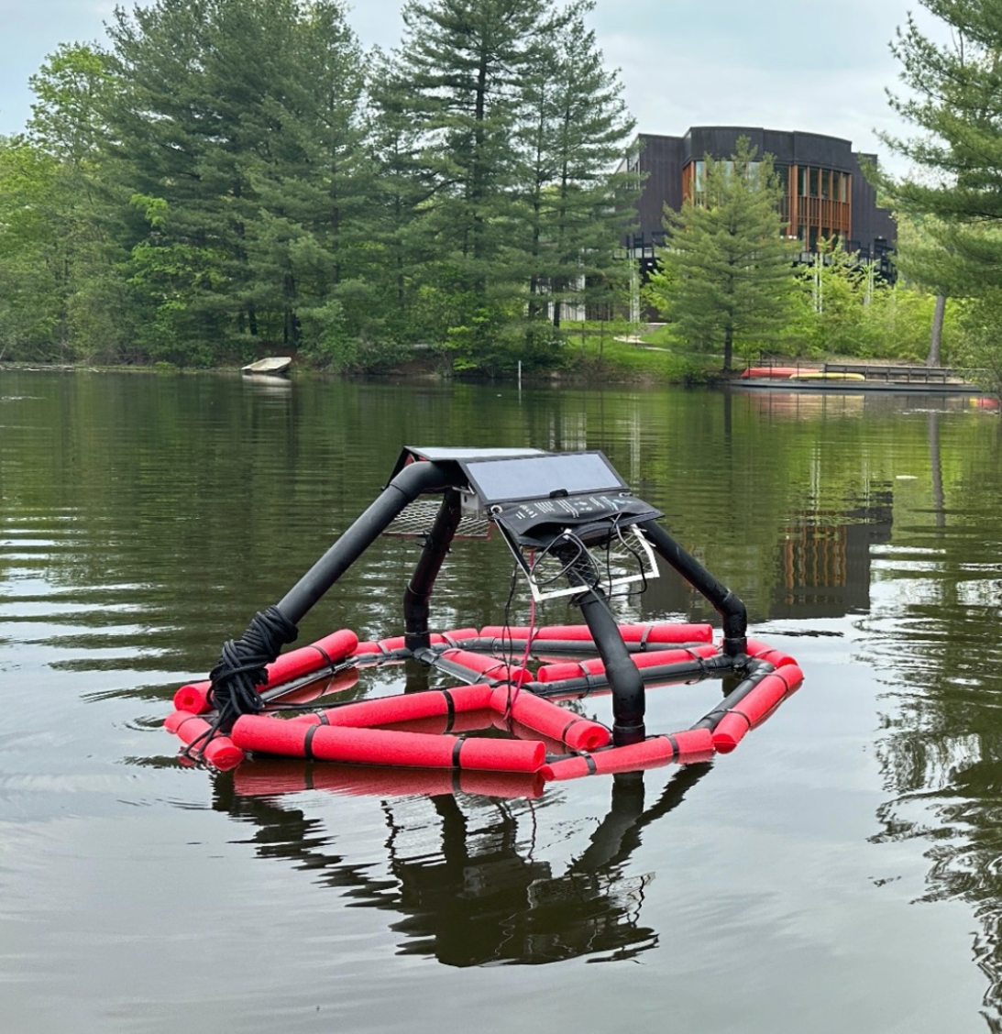
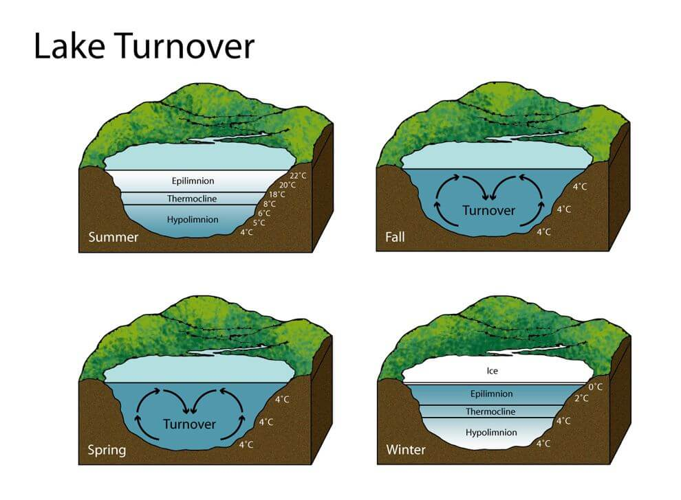
Buoy
The Buoy is a device that floats on Lake Kilroy
Has two sets of data collecting probes
Surface
Ten feet down
Is used to study lake turnover

Slide 7
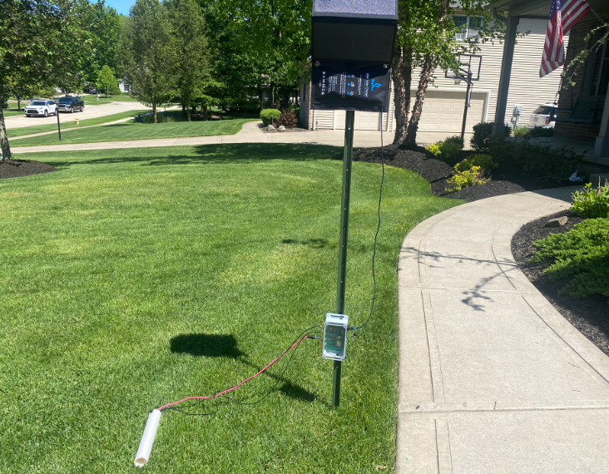
Stationary Device
A stationary device to have the same measurements as the buoy
Can be put in either the inlet or outlet of Lake Kilroy
Mobile and can be put anywhere for classes to use.

Slide 8
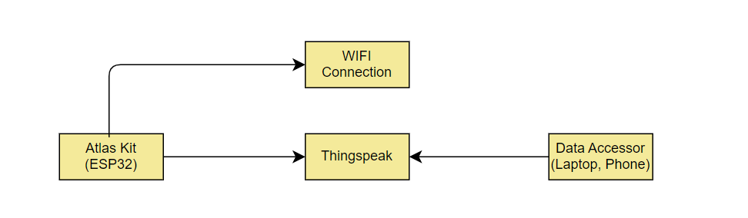
Cloud Water Collection
Each Device uses an Atlas Scientific Kit to measure the water quality.
The Kit connects to a WIFI extender that pushes the school WIFI out to the lake
It then connects to Thingspeak where anyone can access it

Slide 9
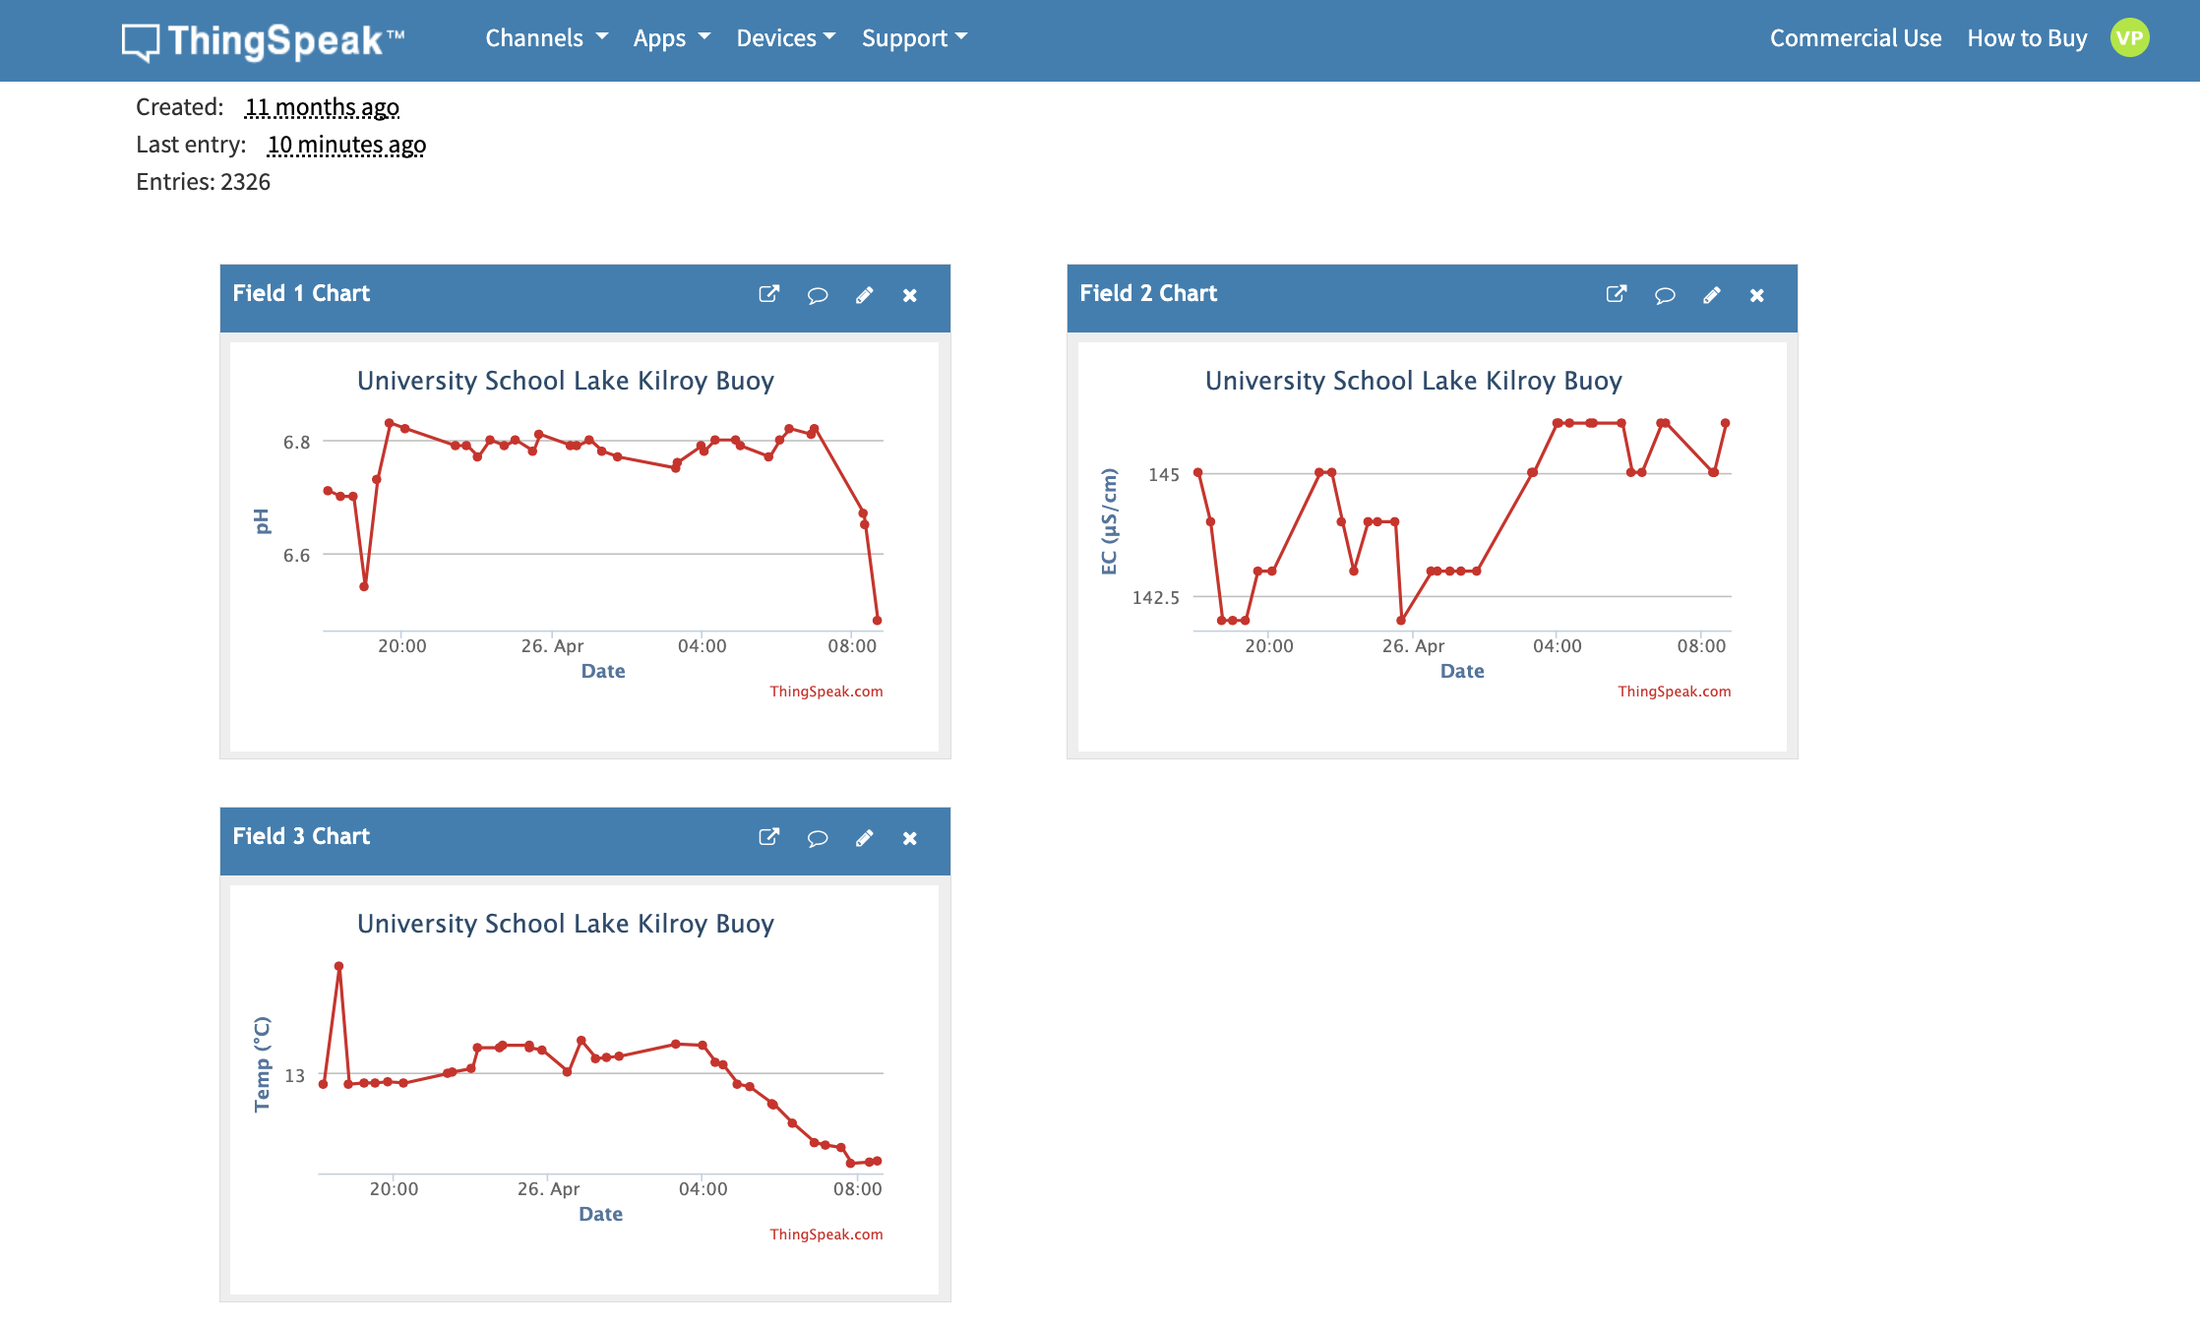
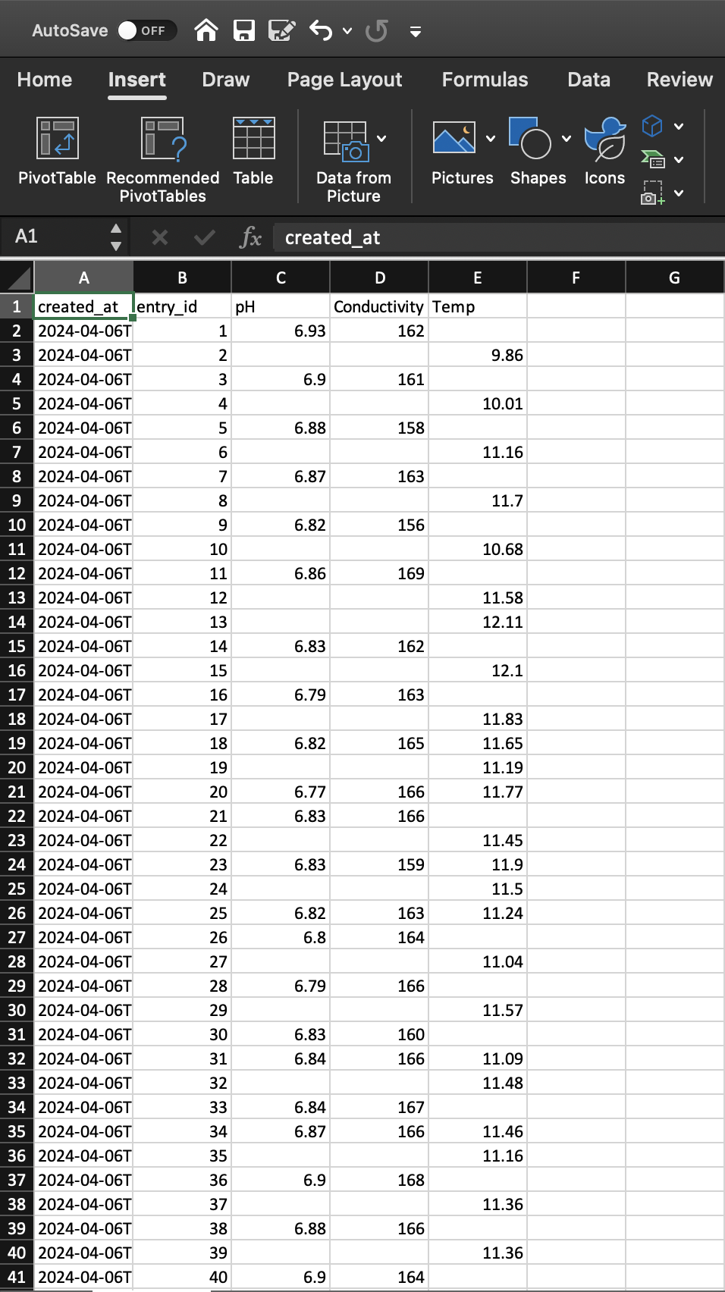
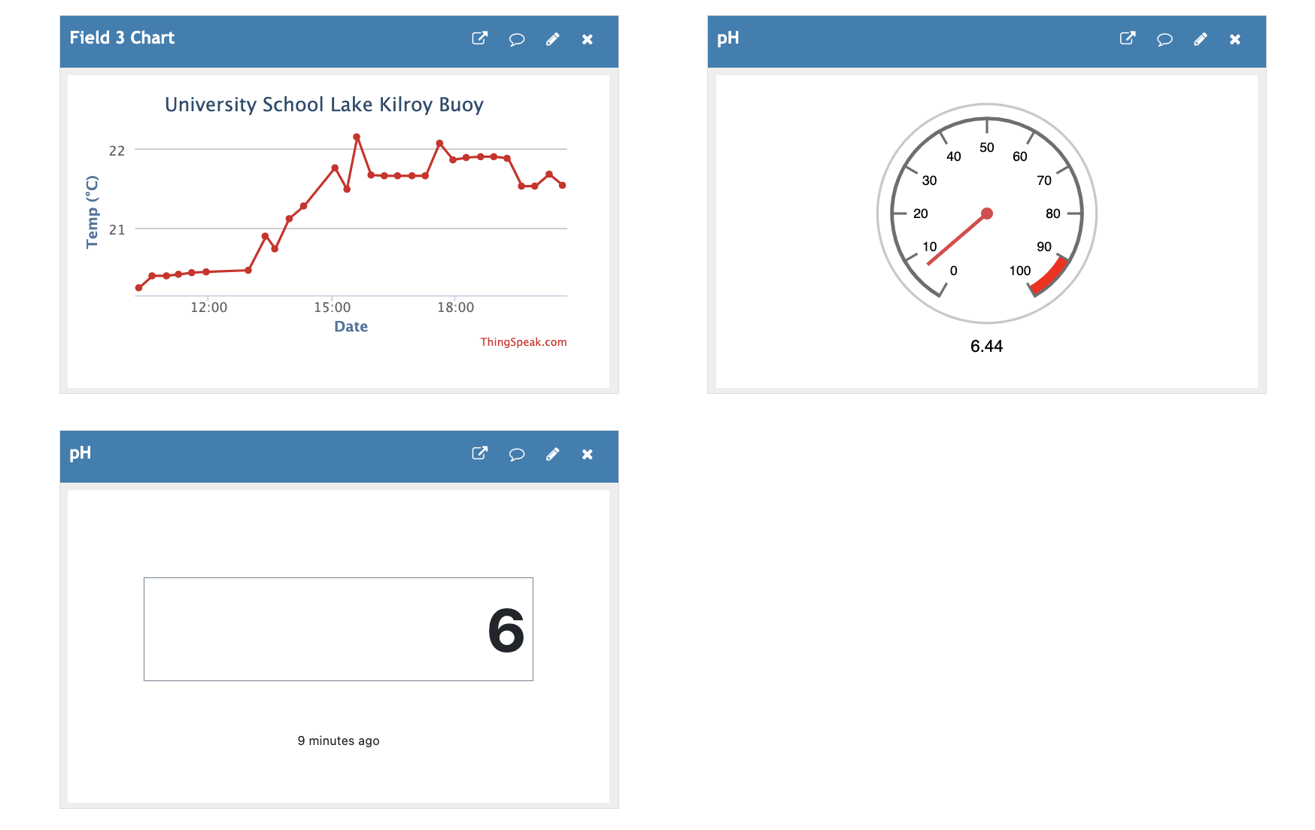
Notes:
Read the notes. Make the picture big
Thingspeak is an IoT platform that allows people to access, plot, visualize and analyze data
It uploads data to the cloud
It’s able to export data to large spreadsheets

Slide 10
Documentation
Create a
engineering journal
User Manual
Google Drive folder

Slide 11
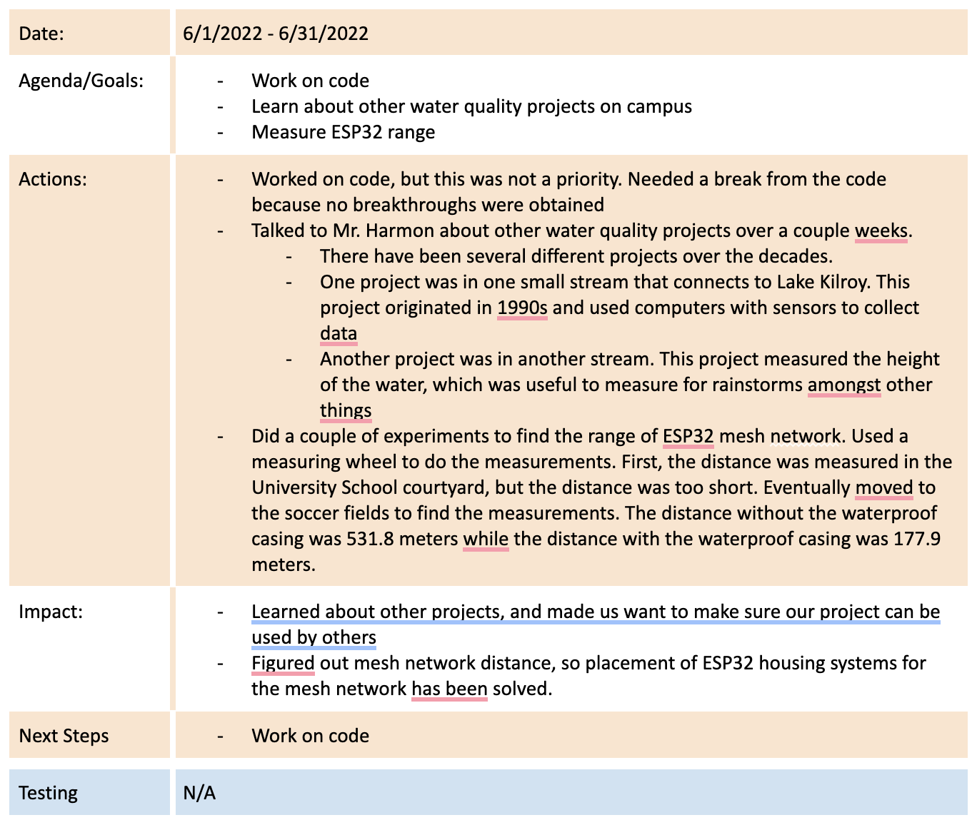
Engineering Journal
Have Documentation of every week that project was worked on
Date
Agenda/Goals
Actions
Impact
Next Steps
Testing

Slide 12
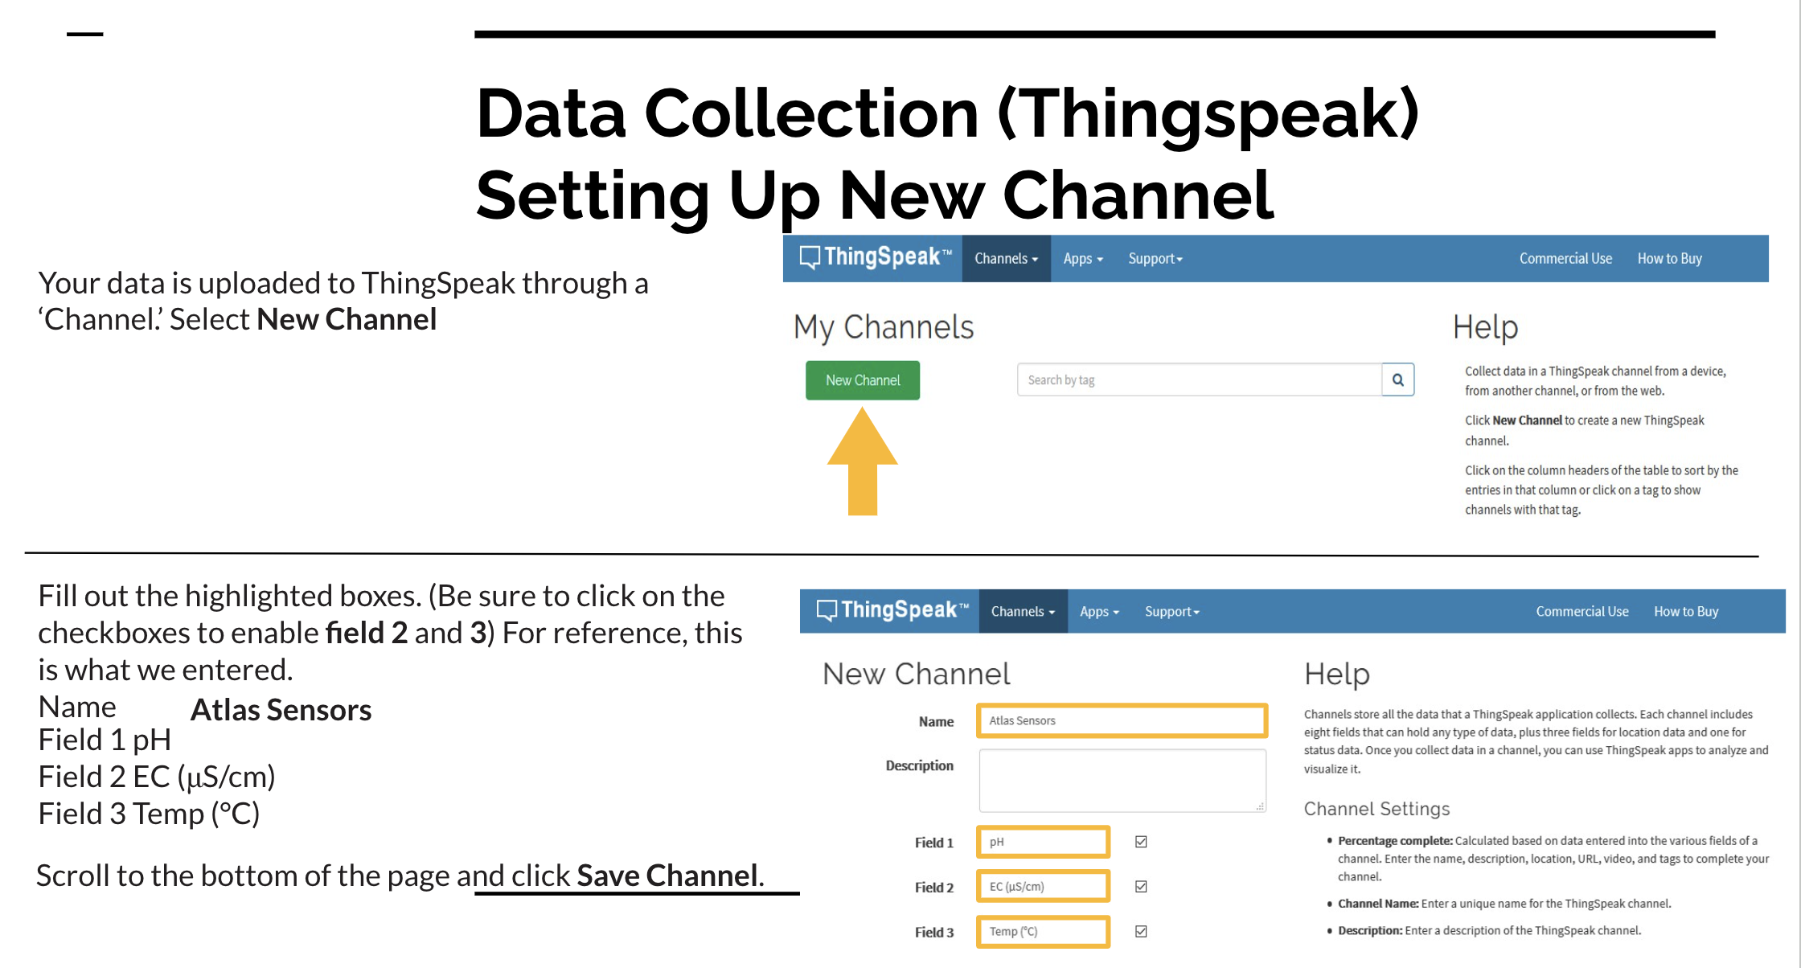
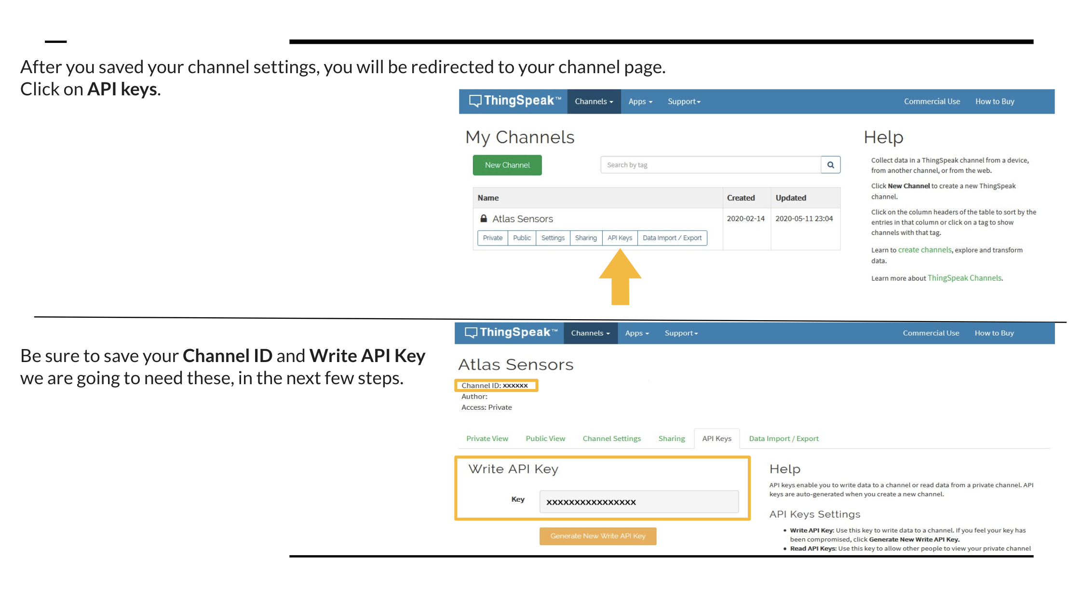
User Manual
Set up a user manual for future students and teachers
Contains info about
Project Overview
Parts used
Assembly
Data Collection
Placement in water
Maintenance
FAQS
Teachers Guide
Every piece of Documentation is neatly organized in Google Drive folder and will be available in the digital archive.

Slide 13
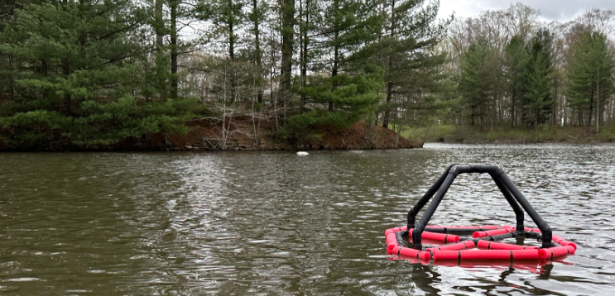
Hard Launch
Launched Buoy in Early March 2024 with two levels of sensors
Launched Stationary Unit in Mid April 2024 at the Inlet of Lake Kilroy

Slide 14
Collaboration
Mr. McKeown
Will be a part of Engineering classes for upkeep and Maintenance
Used to study how to make an Engineering Journal, and a manual for how to use projects in engineering
Statistics
Data can be easily exported for use in statistics
Thingspeak data can be exported to MatLab for more data analyzation
Sciences
Has been used in Oceanography Classes
Hope to be used in other classes such as Microbiology and Biology

Slide 15
Problems Faced
Cable Extenders on Second Level
Had weird data coming through when using second level
Ended having to contact Atlas and calibrate in a different way
Storms
With a lots of rain and wind storms something's broke
The second level solar panel broke and ended up having to open it and solder connects to usb port back
Money
Money ended being tight with an accounting error done by the school
Ended up having around 1000$ for this year (700 less than expected)

Slide 16
Final Products
Buoy with two level of sensor
A versatile stationary device
Documentation for every step of the project
A manual for anyone who use the products in the future
And Especially
- An easy to use experience for anyone who continues or uses the project

Slide 17
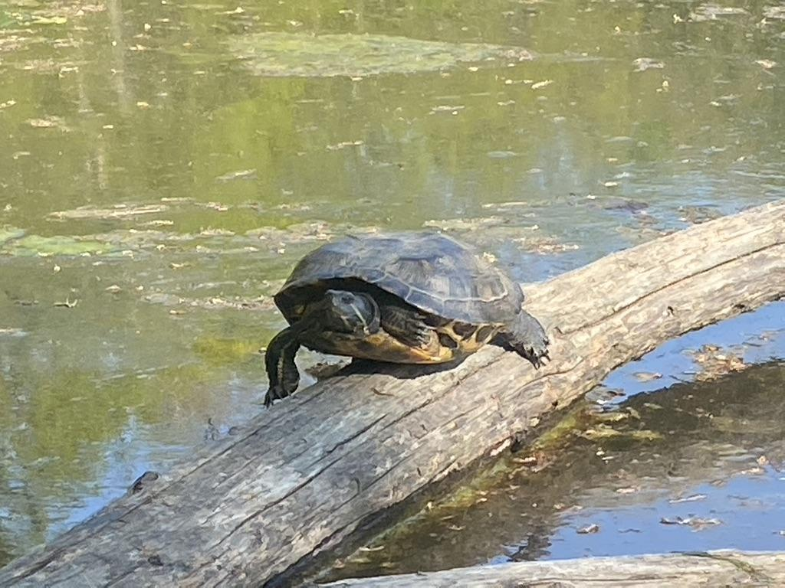
Thanks
Mr. Mckeown
Dr. Smith
Sam Mathews
Ketal and Jinisha Patel
Jack Szabo
Zain Anwar
Ryan Wang
Mrs. Axelrod
Mr. Starinsky
Jeffrey Adair
Mr. Brown
Mrs. Ulery
Mr. Harmon
Nate Abbott
The Strnad Family

